Slide 1
CS 383
Computer Organization and Programming
The History

Slide 2
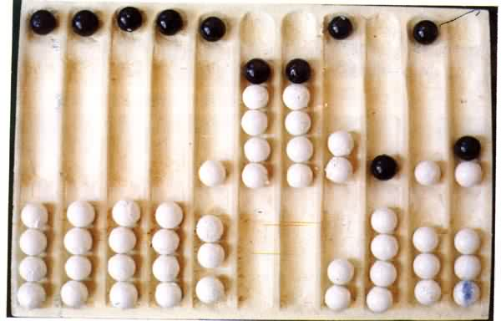
Abacus
The abacus was an early aid for mathematical computations. Its only value is that it aids the memory of the human performing the calculation. A skilled abacus operator can work on addition and subtraction problems at the speed of a person equipped with a hand calculator.

Slide 3
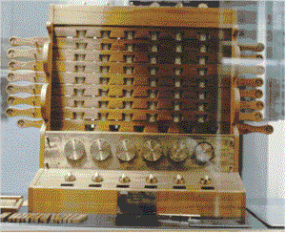
Calculating Clock
The first gear-driven calculating machine to actually be built was probably the calculating clock, so named by its inventor, the German professor Wilhelm Schickard in 1623. This device got little publicity because Schickard died soon afterward in the bubonic plague.

Slide 4
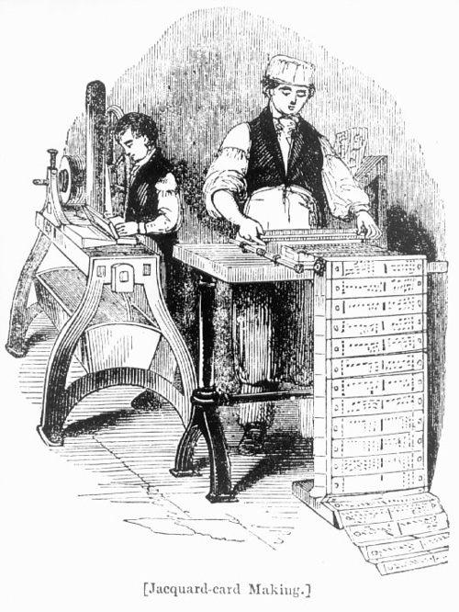
Jacquard’s Loom
By selecting particular cards for Jacquard's loom you defined the woven pattern

Slide 5
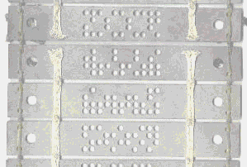
Close up of a card

Slide 6
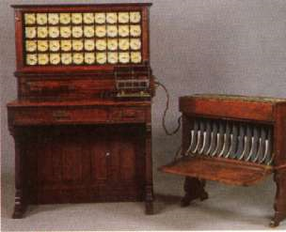
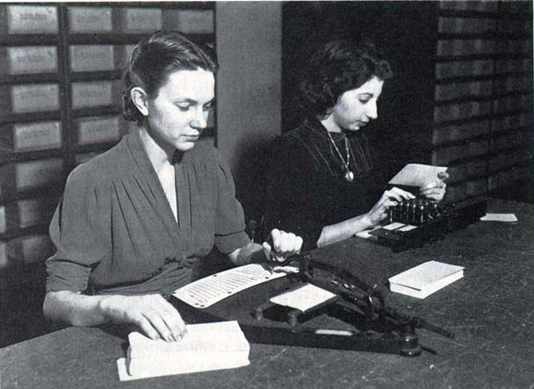
Hollerith Desk

Slide 7

IBM
Hollerith built a company, the Tabulating Machine Company which, after a few buyouts, eventually became International Business Machines, known today as IBM.

Slide 8
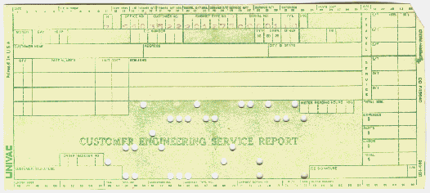
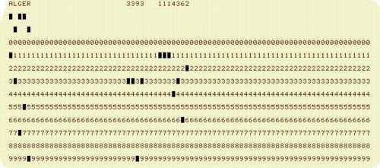
Examples of Punch Cards

Slide 9
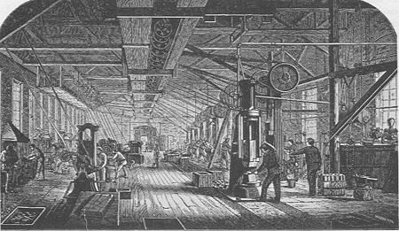
Mark I
One early success was the Harvard Mark I computer which was built as a partnership between Harvard and IBM in 1944.
This was the first programmable digital computer made in the U.S.
But it was not a purely electronic computer. Instead the Mark I was constructed out of switches, relays, rotating shafts, and clutches.

Slide 10
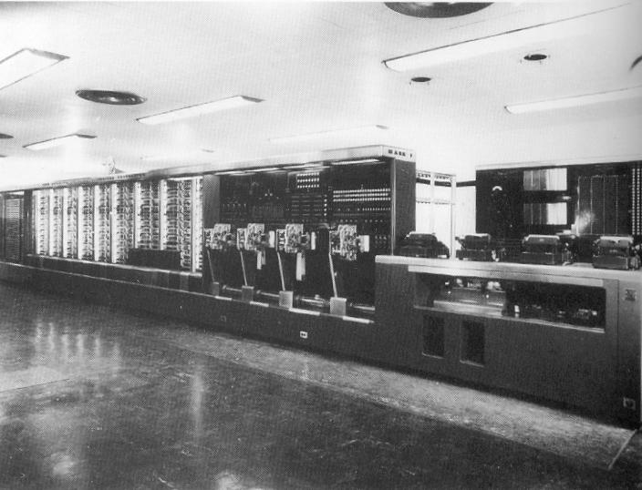
Mark I

Slide 11
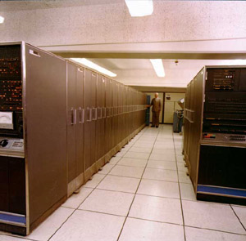
First Generation Computers IBM Stretch - 1959

Slide 12
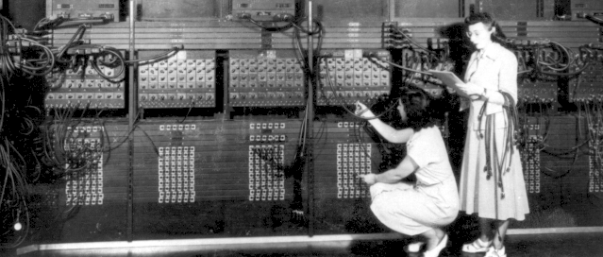
Programming the ENIAC

Slide 13
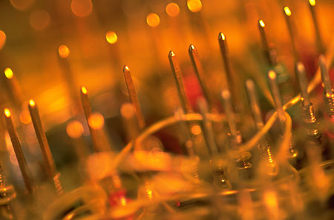
Second Generation Computers
Transistors were replaced by integrated circuits(IC)
One IC could replace hundreds of transistors
This made computers even smaller and faster.

Slide 14
Third Generation Computers
In 1970 the Intel Corporation invented the Microprocessor:an entire CPU on one chip
This led to microcomputers-computers on a desk

Slide 15
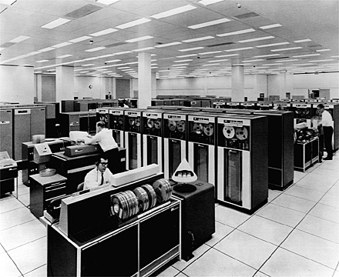
Computer Programming in the ’70’s
If you learned computer programming in the 1970's, you dealt with what today are called mainframe computers, such as the IBM 7090 (shown below), IBM 360, or IBM 370.

Slide 16
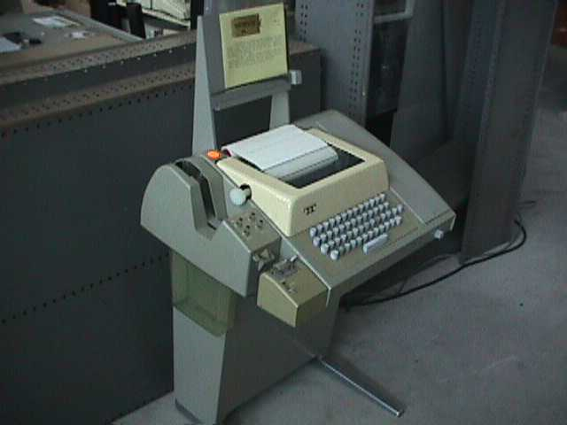
Time-Sharing
There were 2 ways to interact with a mainframe.
The first was called time sharing because the computer gave each user a tiny sliver of time in a round-robin fashion.
Perhaps 100 users would be simultaneously logged on, each typing on a teletype such as the following:

Slide 17
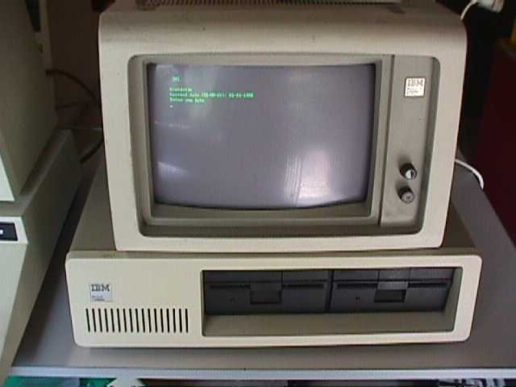
Programming Today
But things changed fast. By the 1990's a university student would typically own his own computer and have exclusive use of it in his dorm room.

Slide 18
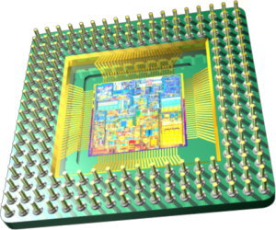
Microprocessor
This transformation was a result of the invention of the microprocessor.
A microprocessor (uP) is a computer that is fabricated on an integrated circuit (IC).
Computers had been around for 20 years before the first microprocessor was developed at Intel in 1971.

Slide 19
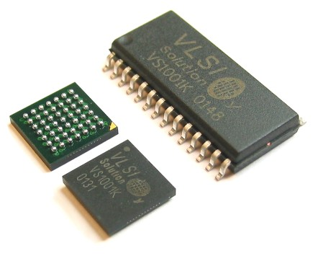
Microprocessor
The micro in the name microprocessor refers to the physical size.
Intel didn't invent the electronic computer, but they were the first to succeed in cramming an entire computer on a single chip (IC)

Slide 20
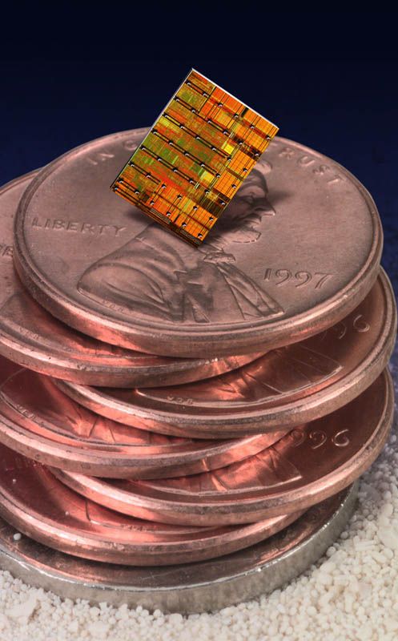
Integrated Circuits
The microelectronics revolution is what allowed the amount of hand-crafted wiring seen in the prior photo to be mass-produced as an integrated circuit which is a small sliver of silicon the size of your thumbnail

Slide 21
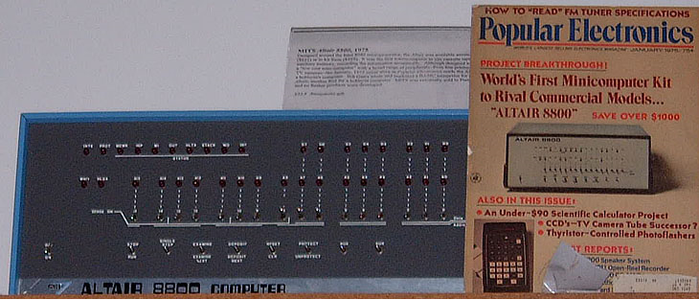
Integrated Circuits
Integrated circuits and microprocessors allowed computers to be faster
This led to a new age of computers
The first home-brew computers is called the ALTAIR 8800

Slide 22
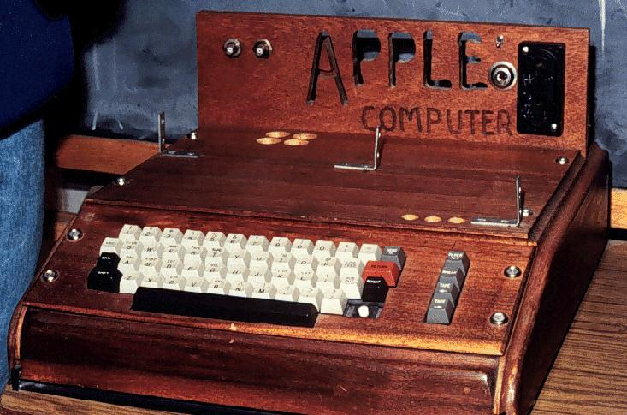
Apple 1 Computer - 1976

Slide 23
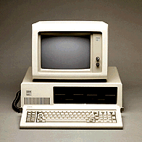
The IBM PC

Slide 24
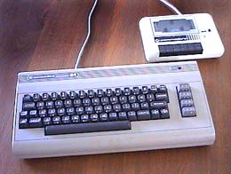
Commodore 64

Slide 25
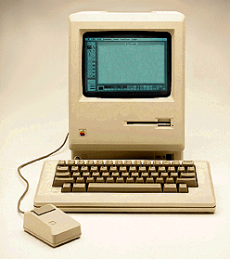
Apple Macintosh

Slide 26
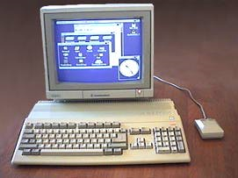
The Amiga

Slide 27
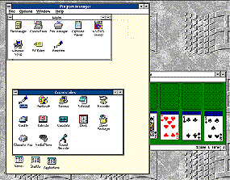
Windows 3

Slide 28
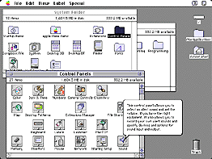
Macintosh System 7

Slide 29
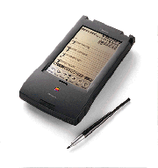
Apple Newton

Slide 30
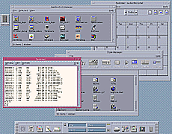
Standard UNIX

Slide 31
Computer System Components
Hardware
Processes data by executing instructions
Provides input and output
Control input, output, and storage components
Software
Applications and system software
Instructions tell hardware exactly what tasks to perform and in what order
Data
Fundamental representation of facts and observations
Communications
Sharing data and processing among different systems

Slide 32
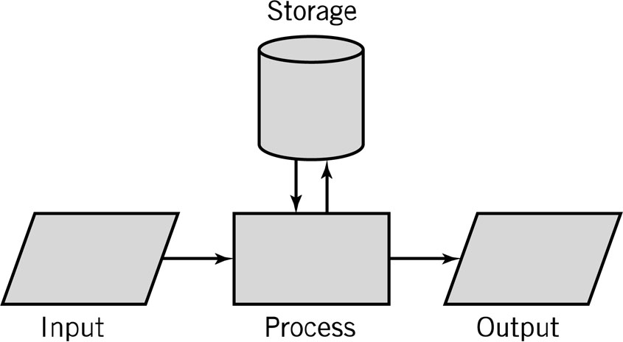
Input-Process-Output Model (IPO)
Input: keyboard, mouse, scanner
Processing: CPU executes the computer program
Output: monitor, printer, fax machine
Storage: hard drive, optical media, diskettes, magnetic tape

Slide 33
Hardware Component
Input/Output devices
Storage Devices
CPU – Central Processing Unit
ALU: arithmetic/logic unit
CU: control unit
Interface unit
Memory
Short-term storage for CPU calculations

Slide 34
CPU: Central Processing Unit
ALU: arithmetic/logic unit
Performs arithmetic and Boolean logical calculations
CU: control unit
Controls processing of instructions
Controls movement of data within the CPU
Interface unit
Moves instructions and data between the CPU and other hardware components
Bus: bundle of wires that carry signals and power between different components

Slide 35
Memory
Also known as primary storage, working storage, and RAM (random access memory)
Consists of bits, each of which hold a value of either 0 or 1 (8 bits = 1 byte)
Holds both instructions and data of a computer program (stored program concept)

Slide 36
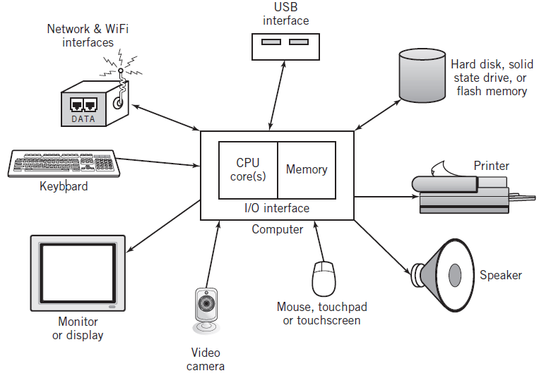
Typical Personal Computer System

Slide 37
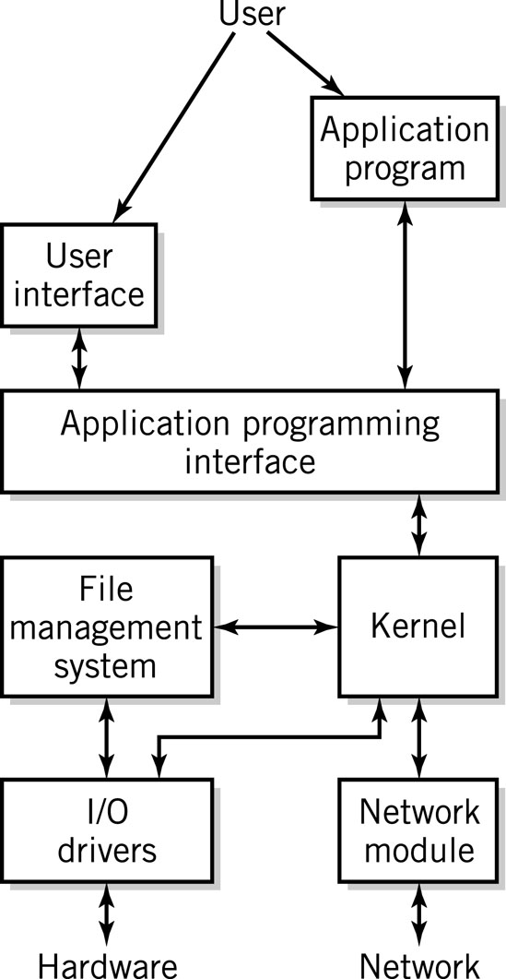
Software Component
Applications
Operating System
API: application program interface
File management
I/O
Kernel
Memory management
Resource scheduling
Program communication
Security
Network Module

